Slide 1
The Financial Crisis
Class 2- The Origins of the Crisis
October 9, 2010

Slide 2
The Housing Market
As I said last week, no one cause is the sole cause of the financial crisis
But the housing market is very important
It is one of the most important causes of the crisis
It is also the sector where the first signs of the problem was observed

Slide 3
How to measure house prices
House prices are tricky to measure?
  Why?
    Illiquidity
    Heterogeneity
Case-Schiller Home Price Index
  Repeat-sales method

Slide 4
Case-Schiller Price Index

Slide 5
How much did home prices rise?
It doubled nationally from 2000 to 2006
Geographic differences
  Southwest
  Northeast
This pattern of geographic differences was one that we had not seen before
  Why?

Slide 6
Case-Schiller: Boston, MA

Slide 7
Case-Schiller: Phoenix, AZ

Slide 8
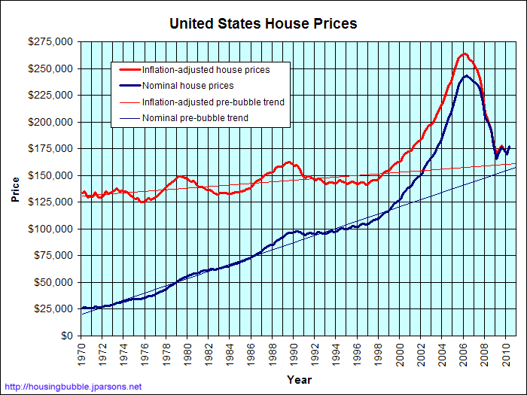
How does this compare historically?

Slide 9
How did home prices rise so much?
Some people blame the Federal Reserve
Abundance of subprime mortgages
Financial innovations
Classic Speculation
  I will not go deeper into the last argument

Slide 10
Basic Monetary Economics
What does the Federal Reserve control?
  Money Supply
  How? Through interest rates
When the Fed raises interest rates, it is called “contractionary” monetary policy
The opposite is called “expansionary”

Slide 11
Federal Reserve
What is this “interest rate”?
Federal Funds Rate
This is the interest that banks pay to each other when they borrow overnight.

Slide 12
Monetary Economics
Once the Fed raises interest rates, that increases the cost of borrowing for households and businesses
Prime Rate=3%+FFR
The economy slows down
The opposite is true as well

Slide 13
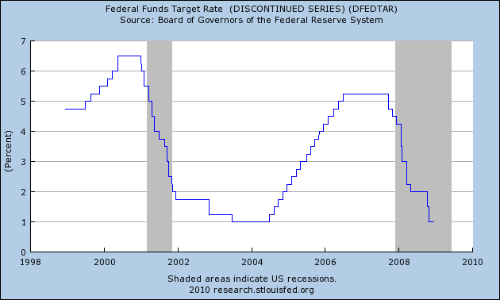
Federal Funds Rate

Slide 14
Too low for too long?
To stimulate the economy after the dot-com bubble, the Fed lowered rates aggressively
Federal Funds Rate remained as low as 1% to 2005
It is claimed that this fueled another bubble

Slide 15
What are subprime Mortgages
Simply put: sub- “prime” mortgage
Borrower does not meet the standards for a “prime” loan
This is normally because of:
  Bad credit
  Low income
  Too much debt already

Slide 16
Subprime Mortgages
For obvious reasons, they have a higher chance of default
Banks can charge a higher price to the borrowers, however
When house prices rose, banks lowered lending standards
Even those who couldn’t get a loan before could do so now

Slide 17
Financial Innovations
There are a multitude of “financial innovations”
But I’m going to talk about only one thing here:
  Mortgage Backed Securities

Slide 18
What are mortgage backed securities (MBS)?

Slide 19
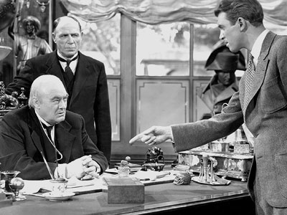
What mortgages used to be:

Slide 20
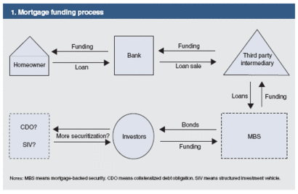
What they are now

Slide 21
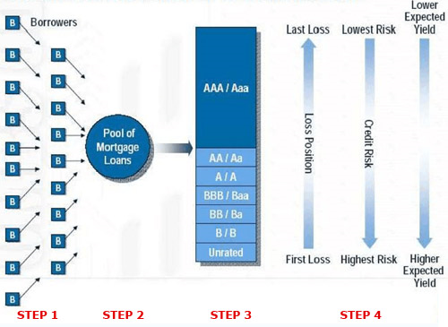
The idea behind MBS

Slide 22
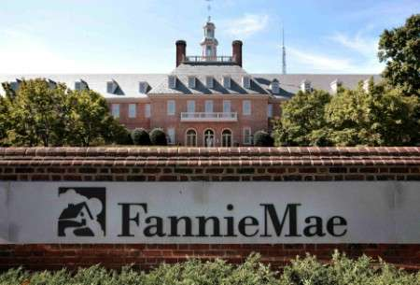
Fannie Mae and Freddie Mac

Slide 23
Fannie and Freddie
Fannie Mae
  FNMA (Federal National Mortgage Assoc.)
Freddie Mac
  Federal Home Loan Mortgage Loan Corporation (FHLMC)
They are “Government-Sponsored Enterprises” (GSEs)
  What are GSEs?

Slide 24
Fannie and Freddie
They buy up mortgages from originators
  Only prime and conforming (<$417K) loans
They then pool them into MBS and sell them to investors
  They also kept some of that MBS
What would be the upsides of this process? Downsides?

Slide 25
What happened in 2007?
Households are overburdened by debt obligations
Delinquency rate on loans begin to rise
The growth in house prices slows down
Credit tightens

Slide 26
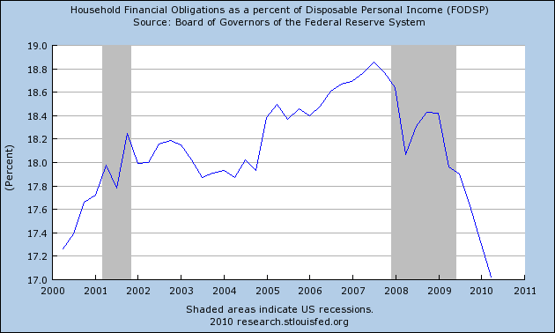

Slide 27
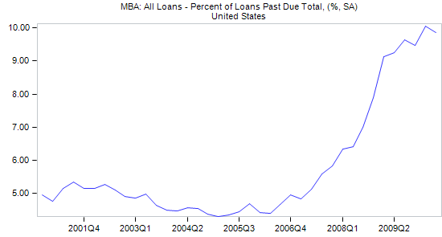

Slide 28
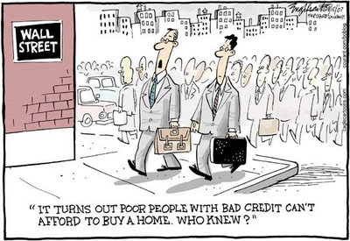

Slide 29
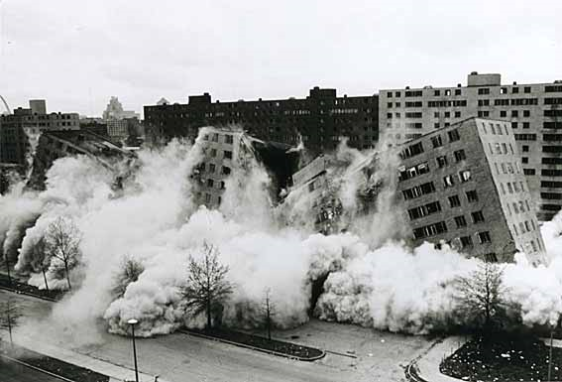
Next week’s preview
Everything collapses

